Slide 1

SHOPPING CART
Presented by:
89
Aryan mole
81
Vedant chavan
88
Prutviraj jadhav
96
Darshana jamage
82
Parshwa sheety

Slide 2

Home
Service
About Us
Contact
Introduction
Shopping cart
shopping cart is a software application used in online stores that allows customers to select and temporarily store products they intend to buy. It acts as a virtual version of the physical cart used in traditional retail stores. The shopping cart typically manages the products selected by the user, calculates the total price including taxes and shipping, and integrates with payment gateways to complete purchases. It's a key component of e-commerce platforms, improving the user experience and enabling seamless online transactions.

Slide 3


Home
Service
About Us
Contact
Objectives
Enable Easy Product Selection and Purchase
01
– Allow users to browse, add items to a cart, and complete transactions smoothly.
Provide Secure Payment Processing
02
– Ensure safe handling of payment and personal data through secure gateways.
Manage Orders and Inventory
03
– Help store owners track sales, stock levels, and fulfill orders efficiently.
Enhance Customer Experience
04
-Offer user-friendly navigation, personalized features, and account management to improve satisfaction.

Slide 4
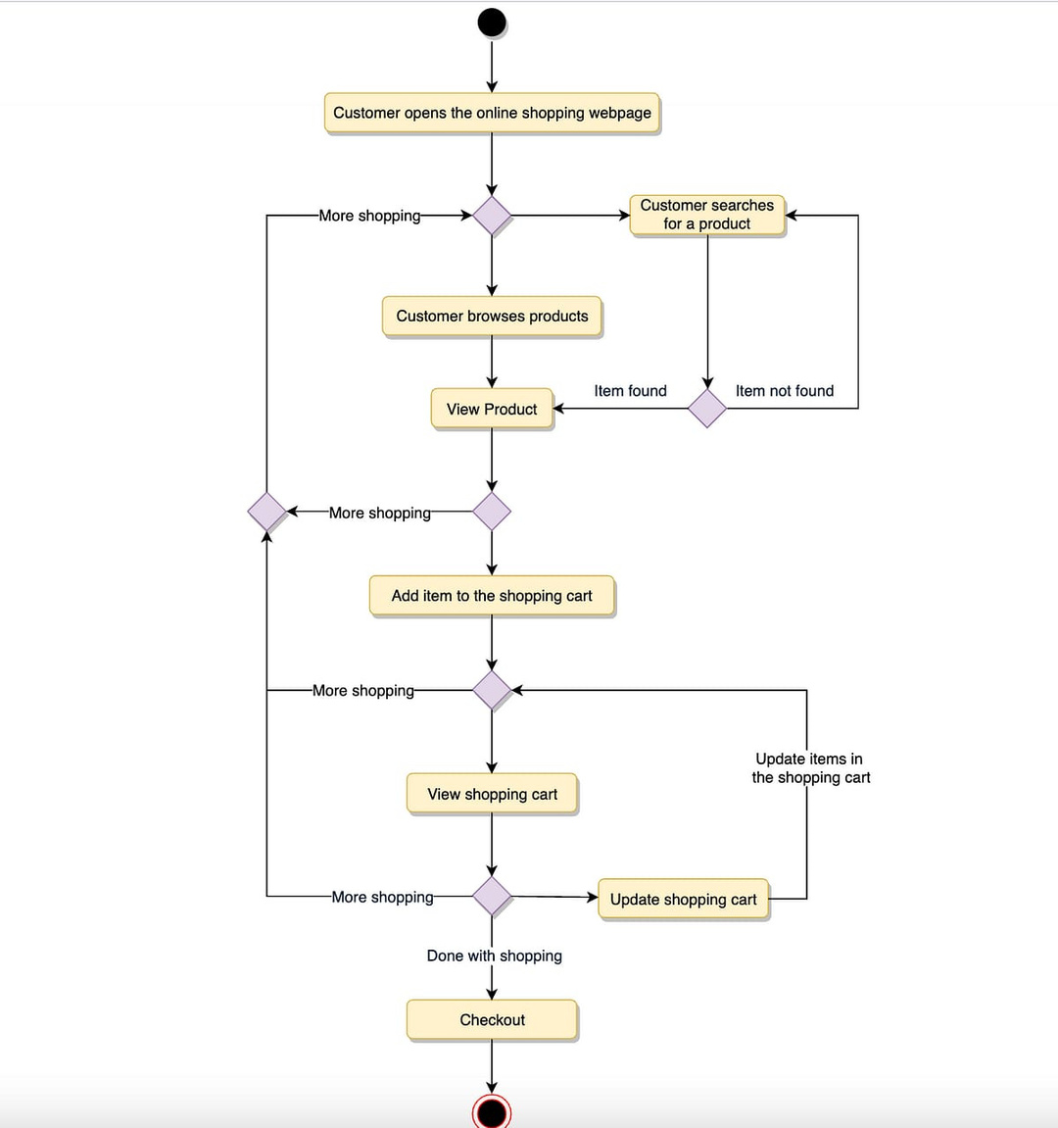
System architecture
Home
Service
About Us
Contact

Slide 5


Home
Service
About Us
Contact
Working
01
dashboard panel
Item,cart, checkout,list of items appears with add to Cart button after clicking add to cart select the quantity pop up
02
Cart
item remove,cart clear, discount options
Checkout
03
bill receipt appers

Slide 6




Home
Service
About Us
Contact
Technology used
Oop and data management
swing components
layout management
01
02
03
Event handling
04

Slide 7
THANK YOU

